Slide 1
Visualizing datasets
Notes:
[Mandatory Slide] This would be the introduction slide of the topic that you are covering in this subsection.
When this slide plays, you could talk about the main aim that we’d be covering in this video.

Slide 2
In this Video, we are going to take a look at…
Data visualization
Matplotlib and Bokeh
Code sample: visualizing plots
Notes:
[Mandatory Slide]
Before the start of the video, we’d like to highlight what are important topics or pointers that we’d be covering in this video. This slide would immediately follow the intro/name slide. This would just be say 2-3 points for the viewers to know what they are getting into.

Slide 3
Data visualization
Data visualization is representing datasets on plots. Viewing plots instead of raw data has a lot of benefits:
allows for “visual exploration” of datasets (something machines are not too good at)
it’s easier to identify macro trends and patterns
it’s good to synthetically describe and present data
it’s easier to compare multiple datasets on the same plot
it’s easier to make predictions on based on current trends/insights
The hard part is choosing the right plot type for the job, as there literally is a ton of them!
time trending → line charts, area charts, bar charts
whole/part relationship → pie charts, ring charts, stack charts
distribution/categorization→ histograms, pie charts, bubble charts, heatmaps, scatter plots
connections → graphs, trees
spacial distribution → maps, cartograms
Notes:
[Mandatory Slide]
Before the start of the video, we’d like to highlight what are important topics or pointers that we’d be covering in this video. This slide would immediately follow the intro/name slide. This would just be say 2-3 points for the viewers to know what they are getting into.

Slide 4
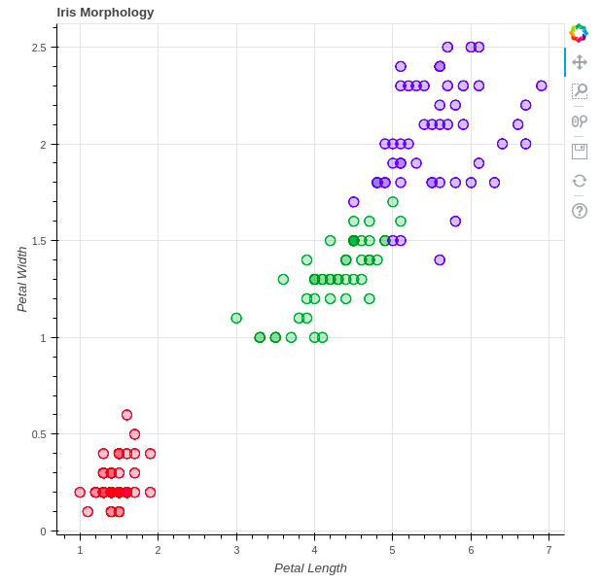
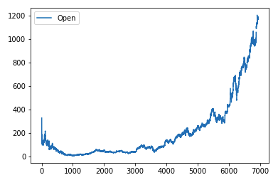
Matplotlib and Bokeh
The Python data science club features a lot of visualization libraries: the most widely used is Matplotlib, which can be installed with pip install matplotlib and is the “mother” of many dataviz libraries for Python
Also Pandas features out of the box visualization functions, but they are only wrappers around Matplotlib’s functions. Eg: you can call df.plot() in order to plot a DataFrame
Another library that helps creating interactive, web-oriented plots is Bokeh: install it with pip install bokeh
Notes:
[Mandatory Slide]
Before the start of the video, we’d like to highlight what are important topics or pointers that we’d be covering in this video. This slide would immediately follow the intro/name slide. This would just be say 2-3 points for the viewers to know what they are getting into.

Slide 5
Code Sample:
visualizing plots
Notes:
Something that needs to grab the viewers attention!!

Slide 6
Summary
Data visualization
Matplotlib and Bokeh
Code sample: visualizing plots
Notes:
[Mandatory Slide]
Before the start of the video, we’d like to highlight what are important topics or pointers that we’d be covering in this video. This slide would immediately follow the intro/name slide. This would just be say 2-3 points for the viewers to know what they are getting into.

Slide 7
Getting insights from
your datasets
Next Section
Notes:
[Mandatory Slide]
Here the name of the next section needs to be mentioned. The narration as you guessed it would be just letting the viewer know what we’d be taking over next! ☺

